Slide 1







COLLEGE OF COMPUTING & INFORMATION TECHNOLOGY
Graduation Project 2024/2025(Part I)
SUPERVISED BY
Dr. Fahima Maghraby
Presentation - 2025
PRESENTED BY :
AHMED EHAB
ABDELRAHMAN IBRAHIM
ABDELRAHMAN BARKY
KAREEM ATEF
YOUNIS MOHAMED
MAHMOUD GAMAL
AI-Driven Social Travel
ARAB ACADEMY FOR SCIENCE, TECHNOLOGY, & MARITIME TRANSPORT

Slide 2

Agenda
1
Introduction
3
Methodology
Motivation
Statistics
Objectives
Scope
Challenges
Features and Functionality
Risks and Mitigations
List of standards
List of Realistic Constraints
AI Technology Used
Software tools
4
User Requirement
Functional Requirements
Non-Functional Requirements
5
System Design
System Architecture
Use Case
Detailed-Use case
Sequence Diagram
Survey Sequence Diagram
Class Diagram
System Prototype
2
Market And Business Analysis
Survey
SWOT Analysis
4 P’s
Business Model Canvas
Financial Plan
Marketing Strategy
Competitors
Literature Review
6
Data Analysis
Data Gathering
Data Visualization
System Prototype
7
Status
8
References

Slide 3
1 . Introduction
Solo travel offers excitement and challenges: finding destinations, managing budgets, and navigating alone.
Many solo travelers seek a solution to simplify planning and connect with others.
TRAVIA bridges this gap as a travel planning and social networking app.
Features AI-driven customization and social interactivity
Designed to create a seamless and engaging solo travel experience.

Slide 4

OVERALL SCOPE & PROBLEM STATEMENT
Motivation
Address personalization gaps in travel planning.
Combine AI and social networking for seamless trips.
Enhance solo travel with real-time connections.
Leverage market growth and emerging technologies.
Innovate with clustering for tailored experiences.

Slide 5
Statistics
The size of the global online travel market is predicted to reach $1.2 trillion in 2027.
50% of travelers spend less than a week doing the research before departing on vacation.
87% of visitors desire to travel sustainably.
The most lucrative online travel market is in Asia-Pacific.
The average traveller makes 38 website visits before deciding and making a booking
References of the above are found at: [6]

Slide 6
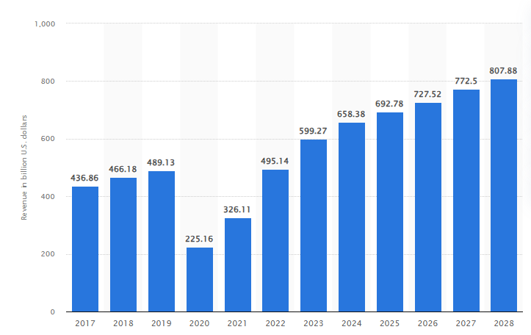
Statistics

Slide 7
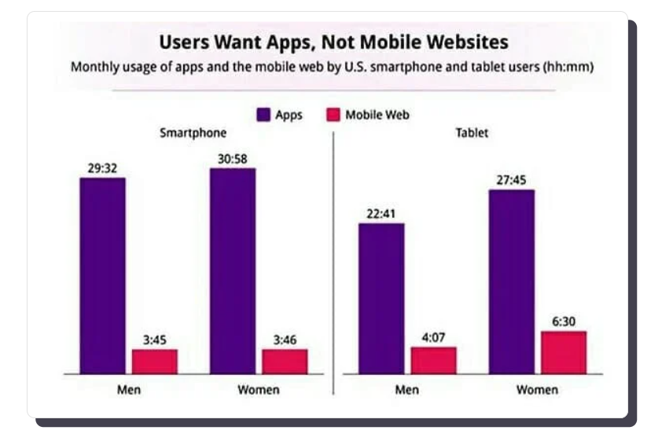
Statistics

Slide 8
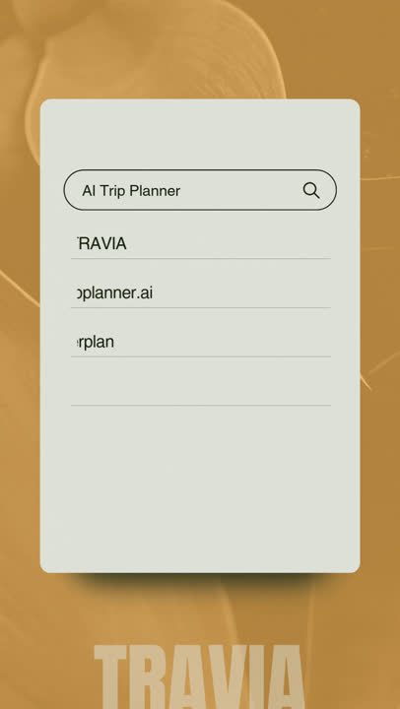
Objectives
Develop cross-platform mobile application
Implement AI planning system
Create secure user authentication
Establish real-time event tracking
Build social networking features

Slide 9

Scope
Develop a solution for travelers.
Study traveler and industry needs.
Analyze gaps in travel planning.
Evaluate existing solutions.
Identify user preferences.
Assess technologies.

Slide 10
Challenges
Cross-Platform Compatibility: Ensuring consistent functionality on both iOS and Android.
Data Privacy and Security: Protecting user data and complying with privacy laws like GDPR.
Real-Time Data Dependence: Managing reliance on third-party APIs for accurate updates.
Scalability: Preparing the system to handle growing user traffic and data demands.
User Experience: Balancing advanced features with ease of use for diverse travelers.

Slide 11
Features and Functionality
Personalized Travel Planning: The AI planner generates tailored travel plans based on user preferences, such as destination, budget, and travel duration.
Social Media Integration: Users can share their plans, view nearby travelers, and explore travel plan similarities to foster social interaction.
Pricing Options: Offers a free model with basic features, subscription plans for frequent travelers, and pay-per-use options for premium features.
Support System: Chatbot assistance for real-time guidance and issue resolution.

Slide 12


Risks and Mitigation
Risk: Data breaches leading to user distrust.
Mitigation: Implement robust encryption and comply with GDPR and other privacy standards.
Risk: High operational costs for AI and server infrastructure.
Mitigation: Optimize resource usage and explore scalable cloud-based solutions.
Risk: Negative user feedback due to inaccurate AI plans.
Mitigation: Continuously improve AI algorithms through user feedback and testing.

Slide 13

List of Standards
ISO 9241-210: Following guidelines for user experience and usability.
ISO/IEC 27001: Ensuring data security management throughout the platform.
GDPR Compliance: Protecting user data in accordance with international privacy laws.
WCAG 2.1: Ensuring accessibility for users with disabilities.

Slide 14

List of Realistic Constraints
Cost/Economics:
Revenue constraints due to reliance on free-tier users versus premium subscriptions.
Ethics:
Ensuring unbiased AI-generated plans that respect diverse user backgrounds and preferences.
Transparent pricing and avoiding manipulative upselling tactics.
Social and Political Impact:
Promoting cultural exchange and sustainable tourism practices.
Avoiding political controversies by respecting regional travel restrictions.

Slide 15
2 . Market And Business Analysis

Slide 16
Survey

Slide 17
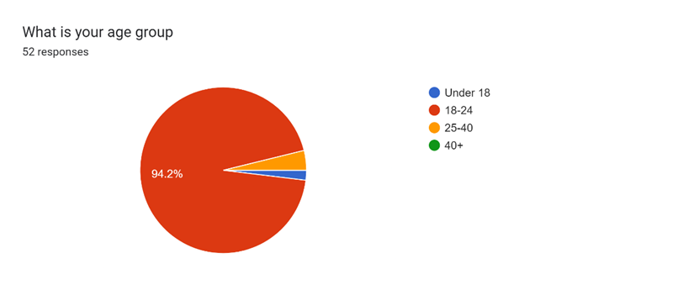

Slide 18
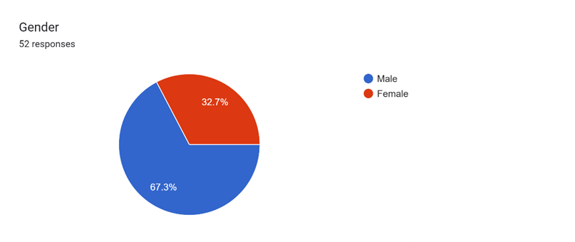

Slide 19
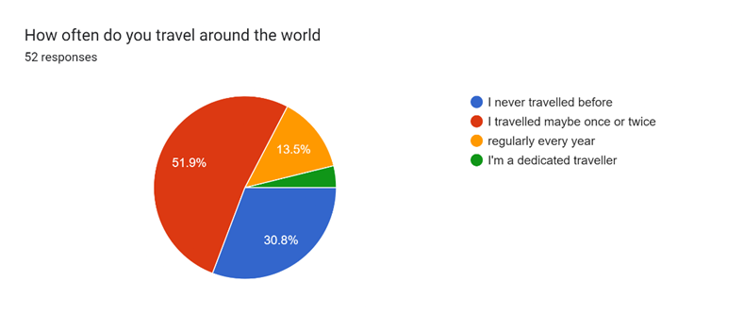

Slide 20
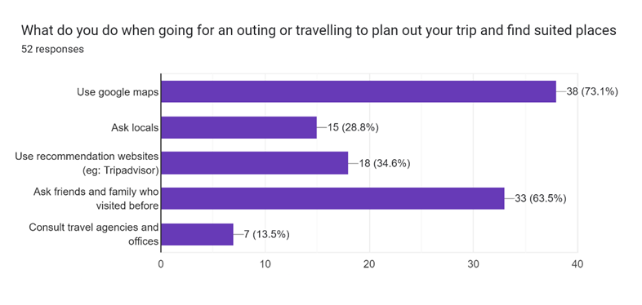

Slide 21
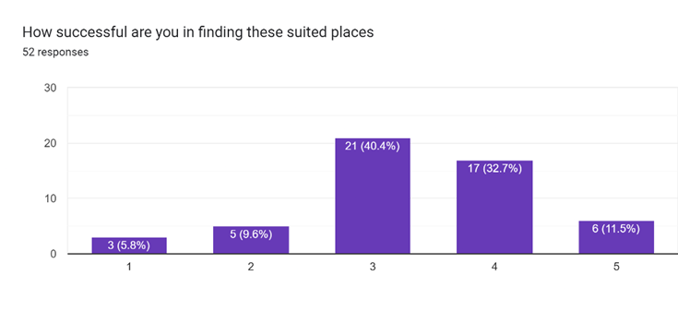

Slide 22
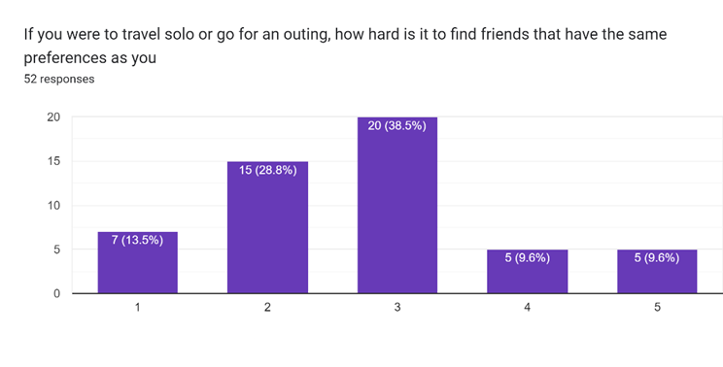

Slide 23
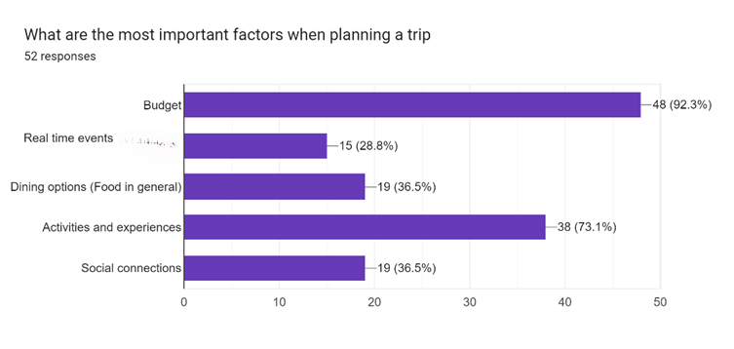

Slide 24
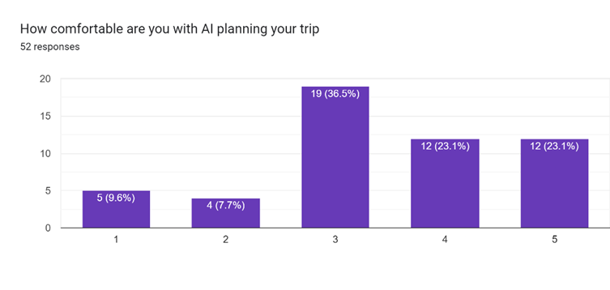

Slide 25
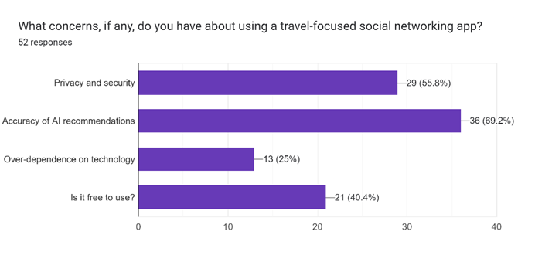

Slide 26
SWOT Analysis

Slide 27
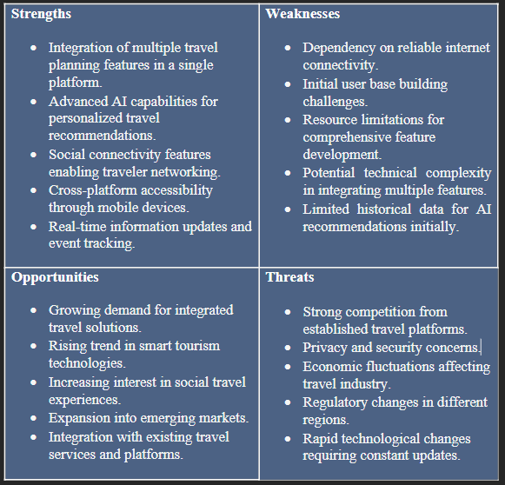

Slide 28
4 P’s

Slide 29
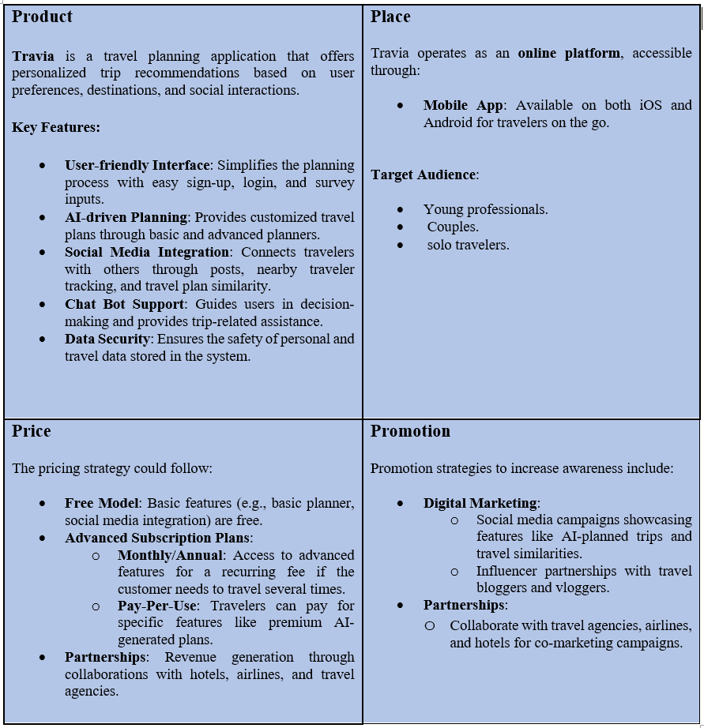

Slide 30
Business Model Canvas

Slide 31
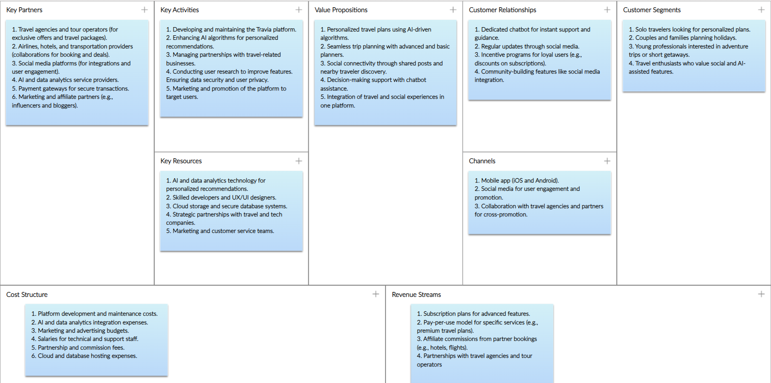

Slide 32
Financial Plan

Slide 33

Fixed Costs for 1 Year:
App Development and Maintenance → $25,000
Marketing and Advertising → $25,000
Salaries (development, management, support staff) → $60,000
Legal, Licensing, and Compliance Costs → $5,000
Total Fixed Costs → $115,000
Variable Costs for 1 Year (for 1,000 users):
Server and Cloud Storage → $8,000
User Acquisition Costs (advertisements, promotions) → $15,000
Customer Support and Service → $7,000
Total Variable Costs → $30,000
Total Costs for 1 Year (for 1,000 users) = Total Fixed Costs + Total Variable Costs = $115,000 + $30,000 = $145,000

Slide 34

Revenue Generation
Sources of Revenue:
Subscription Plans:
Monthly premium subscription fee for advanced features and exclusive offers.
Price: $15/month/user.
Revenue: $15 x 1,000 subscribers/month x 12 months = $180,000
Partnerships with Businesses:
Collaborations with restaurants, hotels, and attractions to promote their services.
Price: $2,000/partner for 50 partners.
Revenue: $2,000 x 50 = $100,000
Affiliate Marketing:
Commissions from bookings made through the app (hotels, flights, etc.).
Revenue: $30,000
Total Revenue = $180,000 + $100,000 + $30,000 = $310,000

Slide 35
Profit
Revenue for 1 Year = $310,000
Profit = Revenue – Total Costs = $310,000 – $145,000 = $165,000
Break-Even Point
Break-Even Point Revenue = Total Costs = $145,000
Break-Even Metrics:
Achieved with 806 premium subscribers or 73 partnerships alone.

Slide 36
Marketing Strategy
Our marketing strategy depends on the following:
Number of app downloads and active users.
Conversion rate from free to premium plan.
Engagement rate on social media.
Revenue growth from subscriptions and partnerships.

Slide 37


Competitors

Slide 38
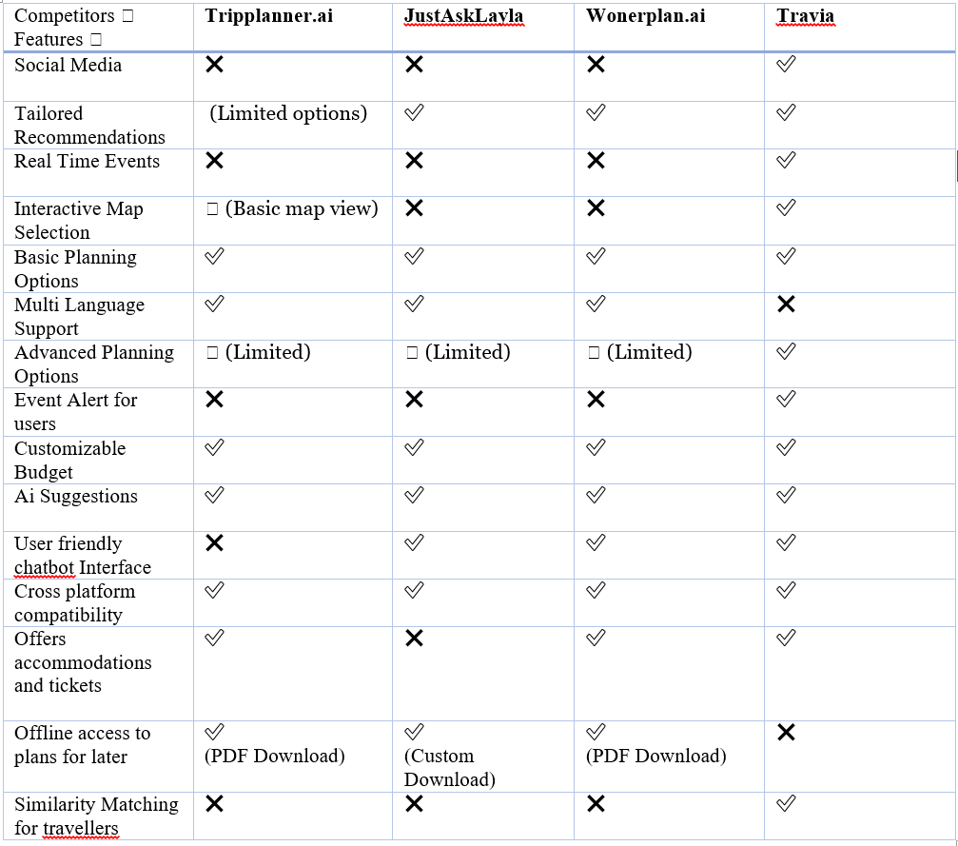

Slide 39
Literature Review

Slide 40
Title, Author, and Publication Year. | Objective | Method | Result | Dataset | Limitations
Travel Itinerary Planner Using AI [1] Authors: Ankita Mudhale1, Madhuri Shirmale2, VedantKudalkar3, Rishikesh Motiray4, Sharique Ahmad5 Publication Year: 2020 | The paper focuses on addressing the limitations of existing travel planning systems, including the lack of personalization, real-time data integration, and user-friendly interfaces. It aims to generate optimized travel itineraries by considering user preferences, real-time constraints, and contextual data like weather and travel duration. | System Architecture: User account management for profile-based planning. Integration of real-time data (e.g., weather, transportation) to dynamically adjust itineraries. AI models like NLP for understanding user inputs and generating tailored recommendations. Integrates user preferences and constraints to generate unique travel plans. | The proposed system delivers: User-friendly interfaces for trip planning. Real-time itinerary adjustments based on contextual changes. High satisfaction due to the integration of user preferences and real-time data. | The system relies on various datasets, including destination attributes, transportation options, and real-time weather data. Data preprocessing steps ensure clean and standardized inputs for machine learning models. | Dependency on reliable real-time data sources, which could lead to inaccuracies in case of network failures. Algorithmic complexity might lead to higher computational requirements.

Slide 41
Title, Author, and Publication Year. | Objective | Method | Result | Dataset | Limitations
A Novel Mean-Shift Algorithm for Data Clustering [2] Authors: Claude Cariou, Steven Le Moan, Kacem Chehdi Publication Year: 2022 | The paper talks about the RMS algorithm and how it aims to improve clustering efficiency and accuracy by combining the strengths of MS and BMS. It is particularly suitable for identifying non-convex clusters and handling datasets with varying densities. Relevance to TRAVIA: our project requires clustering techniques to group users and their preferences for personalized recommendations. RMS's ability to handle non-convex clusters aligns with the need to group travelers with diverse and overlapping preferences effectively. | The RMS algorithm employs a hybrid approach that incorporates kernel-based density estimation and nearest-neighbour techniques. Key aspects include: Kernel-based RMS: Adjusts bandwidth to optimize clustering. NN-based RMS: Uses the nearest neighbours to define clusters dynamically, adapting to local data density. The adaptability of RMS to local densities mirrors the clustering required for personalized recommendations in the social media section of TRAVIA. | Experimental results show that RMS outperforms MS and BMS in terms of: Accuracy and purity of clustering. Computational efficiency due to fewer iterations. Robustness across diverse datasets, including high-dimensional ones. Relevance to TRAVIA: High accuracy and robustness are essential for ensuring meaningful clustering of user preferences and travel plans. Faster convergence of RMS means reduced computational overhead, crucial for real-time applications in our app. | The experiments used synthetic, pure and real-world datasets with diverse configurations and varying dimensionality. Relevance to TRAVIA: Our dataset, encompassing user preferences, travel plans, and real-time events, is likely high-dimensional and diverse, similar to those tested in the study. Metrics like accuracy and purity can help evaluate the clustering models that we integrate into TRAVIA. | The document highlights some limitations: Scalability challenges with large datasets. Dependency on optimal parameter selection (e.g., bandwidth, number of neighbours). Relevance to TRAVIA: Parameter tuning for RMS (e.g., determining optimal K for nearest neighbours) must align with the app's dynamic clustering needs.

Slide 42
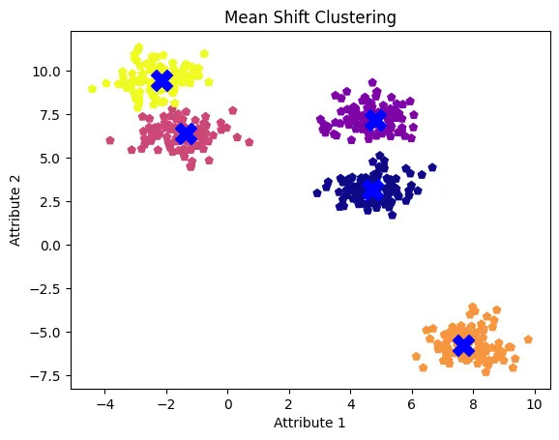

Slide 43
Title, Author, and Publication Year. | Objective | Method | Result | Dataset | Limitations
Clustering And Deep Reinforcement Learning Based Multi-Period Portfolio Management Strategy [3] Authors: Zhengyong Jianga,b, Jeyan Thiayagalingam, Jionglong Su and Jinjun Liang e Publication Year: 2023 | The study aims to optimize portfolio management by clustering financial assets and applying reinforcement learning methods to generate trading actions and determine portfolio allocations. Relation to TRAVIA: The clustering-based approach can be adapted for categorizing destinations or user preferences (e.g., budget-friendly, adventure-focused, etc.) to refine personalized travel recommendations in TRAVIA. Reinforcement learning (RL) strategies align with the needs of dynamic itinerary adjustments in TRAVIA, addressing user feedback and real-time data such as events or location changes. | Clustering: Used the DBSCAN method Reinforcement Learning Relation to TRAVIA: Clustering: The DBSCAN clustering method can group destinations or events based on user preferences and environmental attributes, enabling nuanced recommendations. Reinforcement Learning: A3C and DDPG algorithms can be repurposed for itinerary planning. Metrics: Similar performance metrics, such as user satisfaction or alignment with preferences, can be used to validate TRAVIA’s recommendations. | The integration of clustering with RL outperformed other strategies, achieving higher returns (151.29% cumulative portfolio wealth) and lower risk (Max Drawdown reduced from 0.148 to 0.089). Relation to Travia: The superior performance of clustering and RL in this study underscores their applicability in Travia. By clustering user preferences and applying RL to adaptively refine travel plans, Travia can ensure higher satisfaction rates. Metrics like Max Drawdown can inspire analogous measures (e.g., deviation from user preferences or budget overruns) for assessing travel plan quality. | The study used stock trading data from 800 stocks across the Shanghai Stock Exchange and NASDAQ, leveraging financial indicators for clustering and training RL models. Relation to TRAVIA: Instead of financial indicators, TRAVIA would use datasets comprising user demographics, destination attributes, and preferences. These datasets should include: Budget constraints Real-time events User feedback The structured approach to dataset pre-processing (e.g., dimensionality reduction) is directly transferable to TRAVIA for handling complex, multidimensional user data. | Action Space: The vast action space posed challenges for DDPG in large datasets. Relation to TRAVIA: Dataset Size: Assembling comprehensive data on user behaviour, destinations, and events will be crucial for TRAVIA to achieve reliable clustering and planning outcomes.

Slide 44
Title, Author, and Publication Year. | Objective | Method | Result | Dataset | Limitations
Trip Planner Using Generative AI [4] Authors:K Venkat Manideep1, R Atuliya2, Vinayak Viswan3, Durgapu Aakash Ganesh4, Spoorti B Reddy5, Prof. Sahana Shetty6 Publication Year: 2024 | To create a personalized trip planning application leveraging generative AI for itinerary generation.The paper introduces an AI-powered trip planner that aims to simplify trip planning by offering personalized recommendations and schedules. It leverages user preferences, historical data, and real-time updates to optimize travel experiences | Architecture: Integration of generative AI models for dynamic itinerary creation. Relevance to TRAVIA: NLP & Generative AI: Use fine-tuned language models for surveys and travel plan generation. Recommendation Systems: Suggest destinations and activities using collaborative and content-based filtering. K-Shortest Path: Optimize real-time mapping for efficient routes. Optimization Algorithms: Create personalized itineraries using constraint-based methods. | Achieved 85% accuracy in generating itineraries tailored to user preferences and budget constraints. | Travel-related APIs (e.g., Google Maps, Expedia) and datasets on user reviews, transportation, and accommodations. | Dependency on external APIs for real-time updates and challenges in balancing cost optimization with user personalization.

Slide 45
Title, Author, and Publication Year. | Objective | Method | Result | Dataset | Limitations
Tuning Reinforcement Learning Parameters for Cluster Selection to Enhance Evolutionary Algorithms [5] Authors: Nathan Villavicencio and Michael N. Groves Publication Year: 2024 | To optimize travel recommendations using AI by balancing exploration and exploitation in user clustering. | Reinforcement learning with dynamic cluster selection, parameter optimization using grid search, Gaussian distribution modeling for preference prediction. Example on TRAVIA: Cluster 1: Adventure-seekers. Cluster 2: Luxury-seekers. Cluster 3: Budget-friendly travelers. RL learns: Cluster 1 generates popular recommendations → Reward. Cluster 3 is overused → Penalize. Outcome: TRAVIA optimizes recommendations based on user feedback and data. | Achieved 75.2% success rate in accurate cluster-based recommendations, outperforming baseline methods by 41%. | User preference clusters generated from travel APIs and historical travel behavior data. | High computational cost for tuning parameters; sensitivity to initial clustering thresholds.

Slide 46
3 . Methodology

Slide 47

AI Technologies used
This project integrates a range of advanced AI technologies and robust preprocessing techniques to create a seamless system for accurate, efficient, and personalized recommendations. By addressing the challenges inherent in raw and unstructured data, the system ensures that AI models can function optimally and deliver actionable insights. The workflow can be divided into two key phases: data preprocessing and AI-driven decision-making
1) Data Preprocessing for AI system
2) AI-driven decision-making :
1) Clustering Learning
2) Reinforcement Learning

Slide 48
1) Data Preprocessing for AI system
Data Preprocessing can be Broken into 3 steps :
1) Handling Missing Values
Using Imputer :
Most Frequent for string columns
Mean for numerical columns
2) Encoding Categorical Data
Label Encoding:
Converted categorical features like True/False to 0/1 using LabelEncoder (e.g. attributes_OutdoorSeating)
Multilabel Binarizer:
Applied to multi-category fields (e.g., category column)

Slide 49
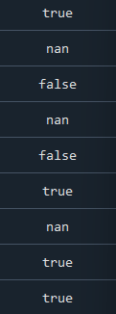
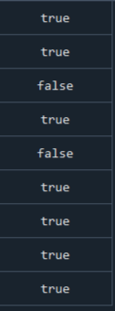
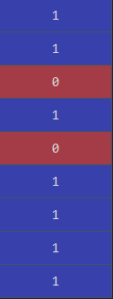
Handling Missing Values
Encoding Categorical Data
Label Encoding

Slide 50
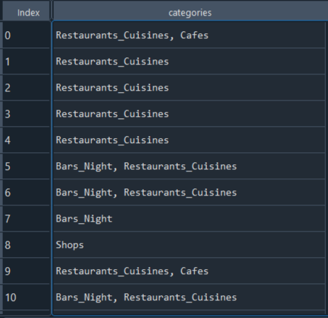
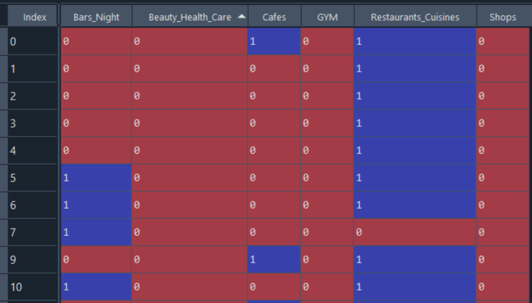
Encoding Categorical Data
Multilabel Binarizer

Slide 51
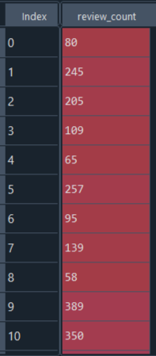
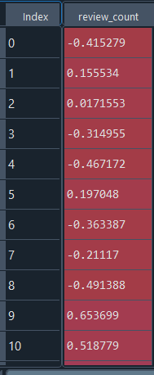
1) Data Preprocessing for AI system
3) Feature Scaling
Using Standard Scaler
Standardized data to a range of [-3,3] using StandardScaler for consistent scaling across numerical features.

Slide 52
2) AI Technologies used
1) Clustering Learning
3) Steps of Mean Shift?
1) Initialization
Place a "kernel" (like a window or circle)
around each data point
2) Shift Towards Density
Calculate the mean (average) of all points within the kernel.
Move the kernel center to this mean, which shifts it towards areas of higher density.
3) Repeat Until Convergence
Continue shifting the kernel until it stops moving significantly or stabilizes
Points whose kernels converge to the same position belong to the same cluster

Slide 53
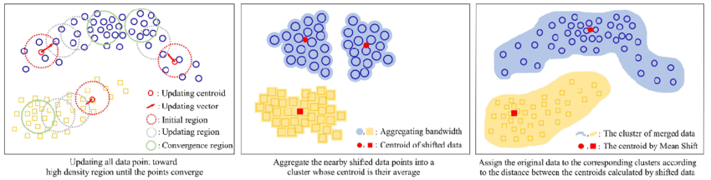
2) AI Technologies used
2) Clustering Learning
3) Steps of Mean Shift?
4) Assign Clusters
Group data points based on the kernel centers to form clusters

Slide 54
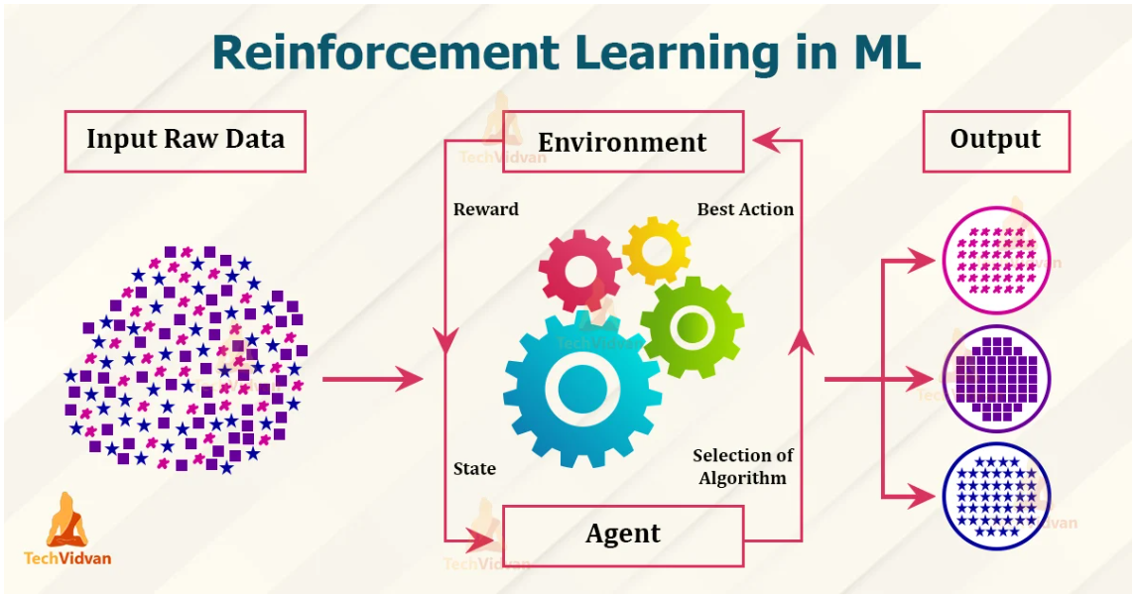
AI Technologies used
3) Reinforcement Learning

Slide 55
2) AI Technologies used
3) Reinforcement Learning
Two Cluster Action Selection Methods:
1) PPO-Based Cluster Selection
2) Dynamic Probability-Based Cluster Selection
Mechanism
Calculates the similarity between user preferences and the aggregate features of each cluster (e.g., using Euclidean distance).
Multiplies the similarity score with the prior probability of selecting that cluster.
Normalizes the resulting probabilities.
Selects the cluster with the highest probability.
Learning Feedback:
Positive Reward: Increases the probability of selecting the cluster in future iterations.
Negative Reward: Decreases the probability of selecting the cluster.

Slide 56
2) AI Technologies used
3) Reinforcement Learning
Two Cluster Action Selection Methods:
2) Dynamic Probability-Based Cluster Selection
limitations
It doesn't consider sequential decision-making as effectively as PPO.
It may struggle with complex environments where the relationship between user preferences and clusters changes over time.
because of this limitations we recommend using PPO action selection rather than Dynamic Probability-Based Cluster Selection

Slide 57
2) AI Technologies used
3) Reinforcement Learning
1) Cluster Selection Using RL
1) Agent’s Action
The RL agent selects a cluster based on the current state and policy from precomputed clusters.
The agent chooses the cluster with the highest expected reward based on how well it matches the user’s preferences.
2) Reward Signal:
Positive Reward: If the selected cluster leads to high user satisfaction.
Negative Reward: If the selected cluster does not align with user preferences.

Slide 58
AI Technologies used
3) Reinforcement Learning
1) Cluster Selection Using RL
3) Policy Update
Positive reward: The agent adjusts its policy to select clusters that are similar to the one that led to positive feedback. For example, if a user likes a cluster with a particular location or activity type, the agent will prioritize clusters with similar features in the future.
Negative reward: The agent adjusts its policy to avoid selecting clusters that led to poor user satisfaction, steering away from clusters that didn’t meet the user’s expectations.

Slide 59
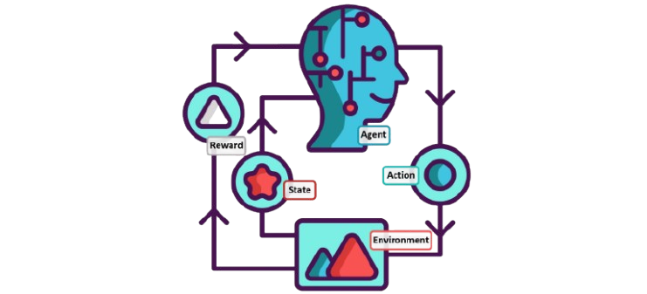
AI Technologies used
3) Reinforcement Learning
2) Row Selection Using RL
1) Subset Selection:
Once a cluster is selected, the RL agent selects k-rows sequentially for the k-day trip plan
2) Iterative Decision-Making
The agent evaluates each row for:
Alignment with user preferences.
Remaining trip constraints (time, budget, etc.).
3) Reward for Row Selection:
Positive Reward: High satisfaction with the chosen trip plan.
Negative Reward: Plan misaligned with user expectations.

Slide 60
Software tools

Slide 61






Flutter
Dart
Android Studio
Python (for AI Module)
Spyder
Web Scraping(google maps data for the selected city)
Flask(connect app we ai module)
Firebase (Authentication)
Artificial Intelligence

Slide 62
4 . User Requirments

Slide 63




Functional Requirements
Register
Login
Survey Submission
The user creates an account through their phone number or E-mail.
The user may also choose to create an account through their social media platform of choice.
The user enters their credentials to log in to their already registered account.
This may be through their mobile number, E-mail, or social media account.
The user enters personal information so that the system could view preferred choices to them that includes:
User Age.
User Gender.
User Relationship Statues.

Slide 64



Functional Requirements
Destination Selection
AI Travel Planner
Social Media Integration
User selects which location they want to learn more about to potentially choose that destination to travel to.
User chooses the basic AI travel planner to plan their trip.
User chooses the advanced AI travel planner to plan their trip.
After finalizing the trip, the user accesses the Social Media Section.
(It’s Not a must that the user access social media After generating his plan)

Slide 65
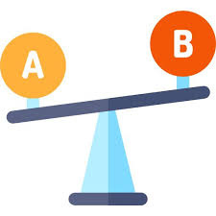
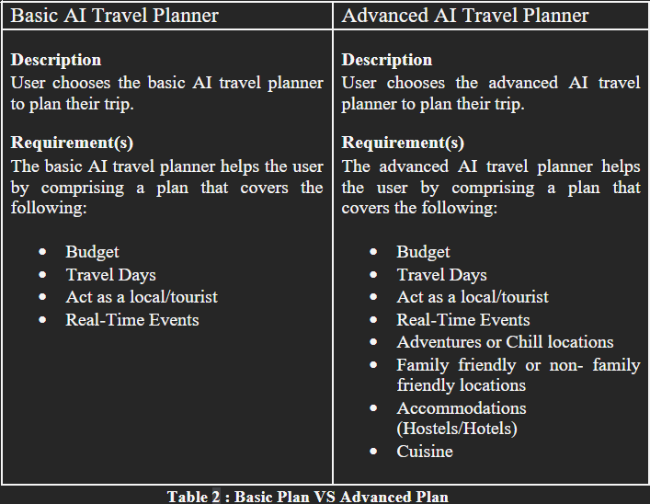




Basic VS Advanced AI Planner
Also The Basic Plan Is free for Any User, But The Advanced Needs A Subscription Plan:
Monthly
Once Per Use

Slide 66
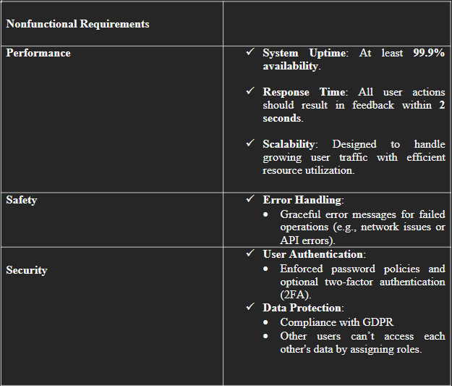





Non-Functional Requirements

Slide 67
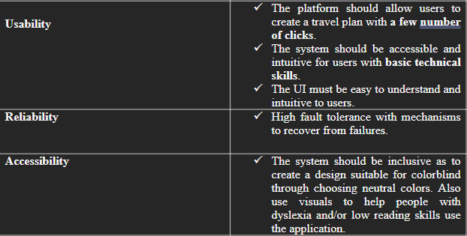

Non-Functional Requirements

Slide 68
5. System Design

Slide 69
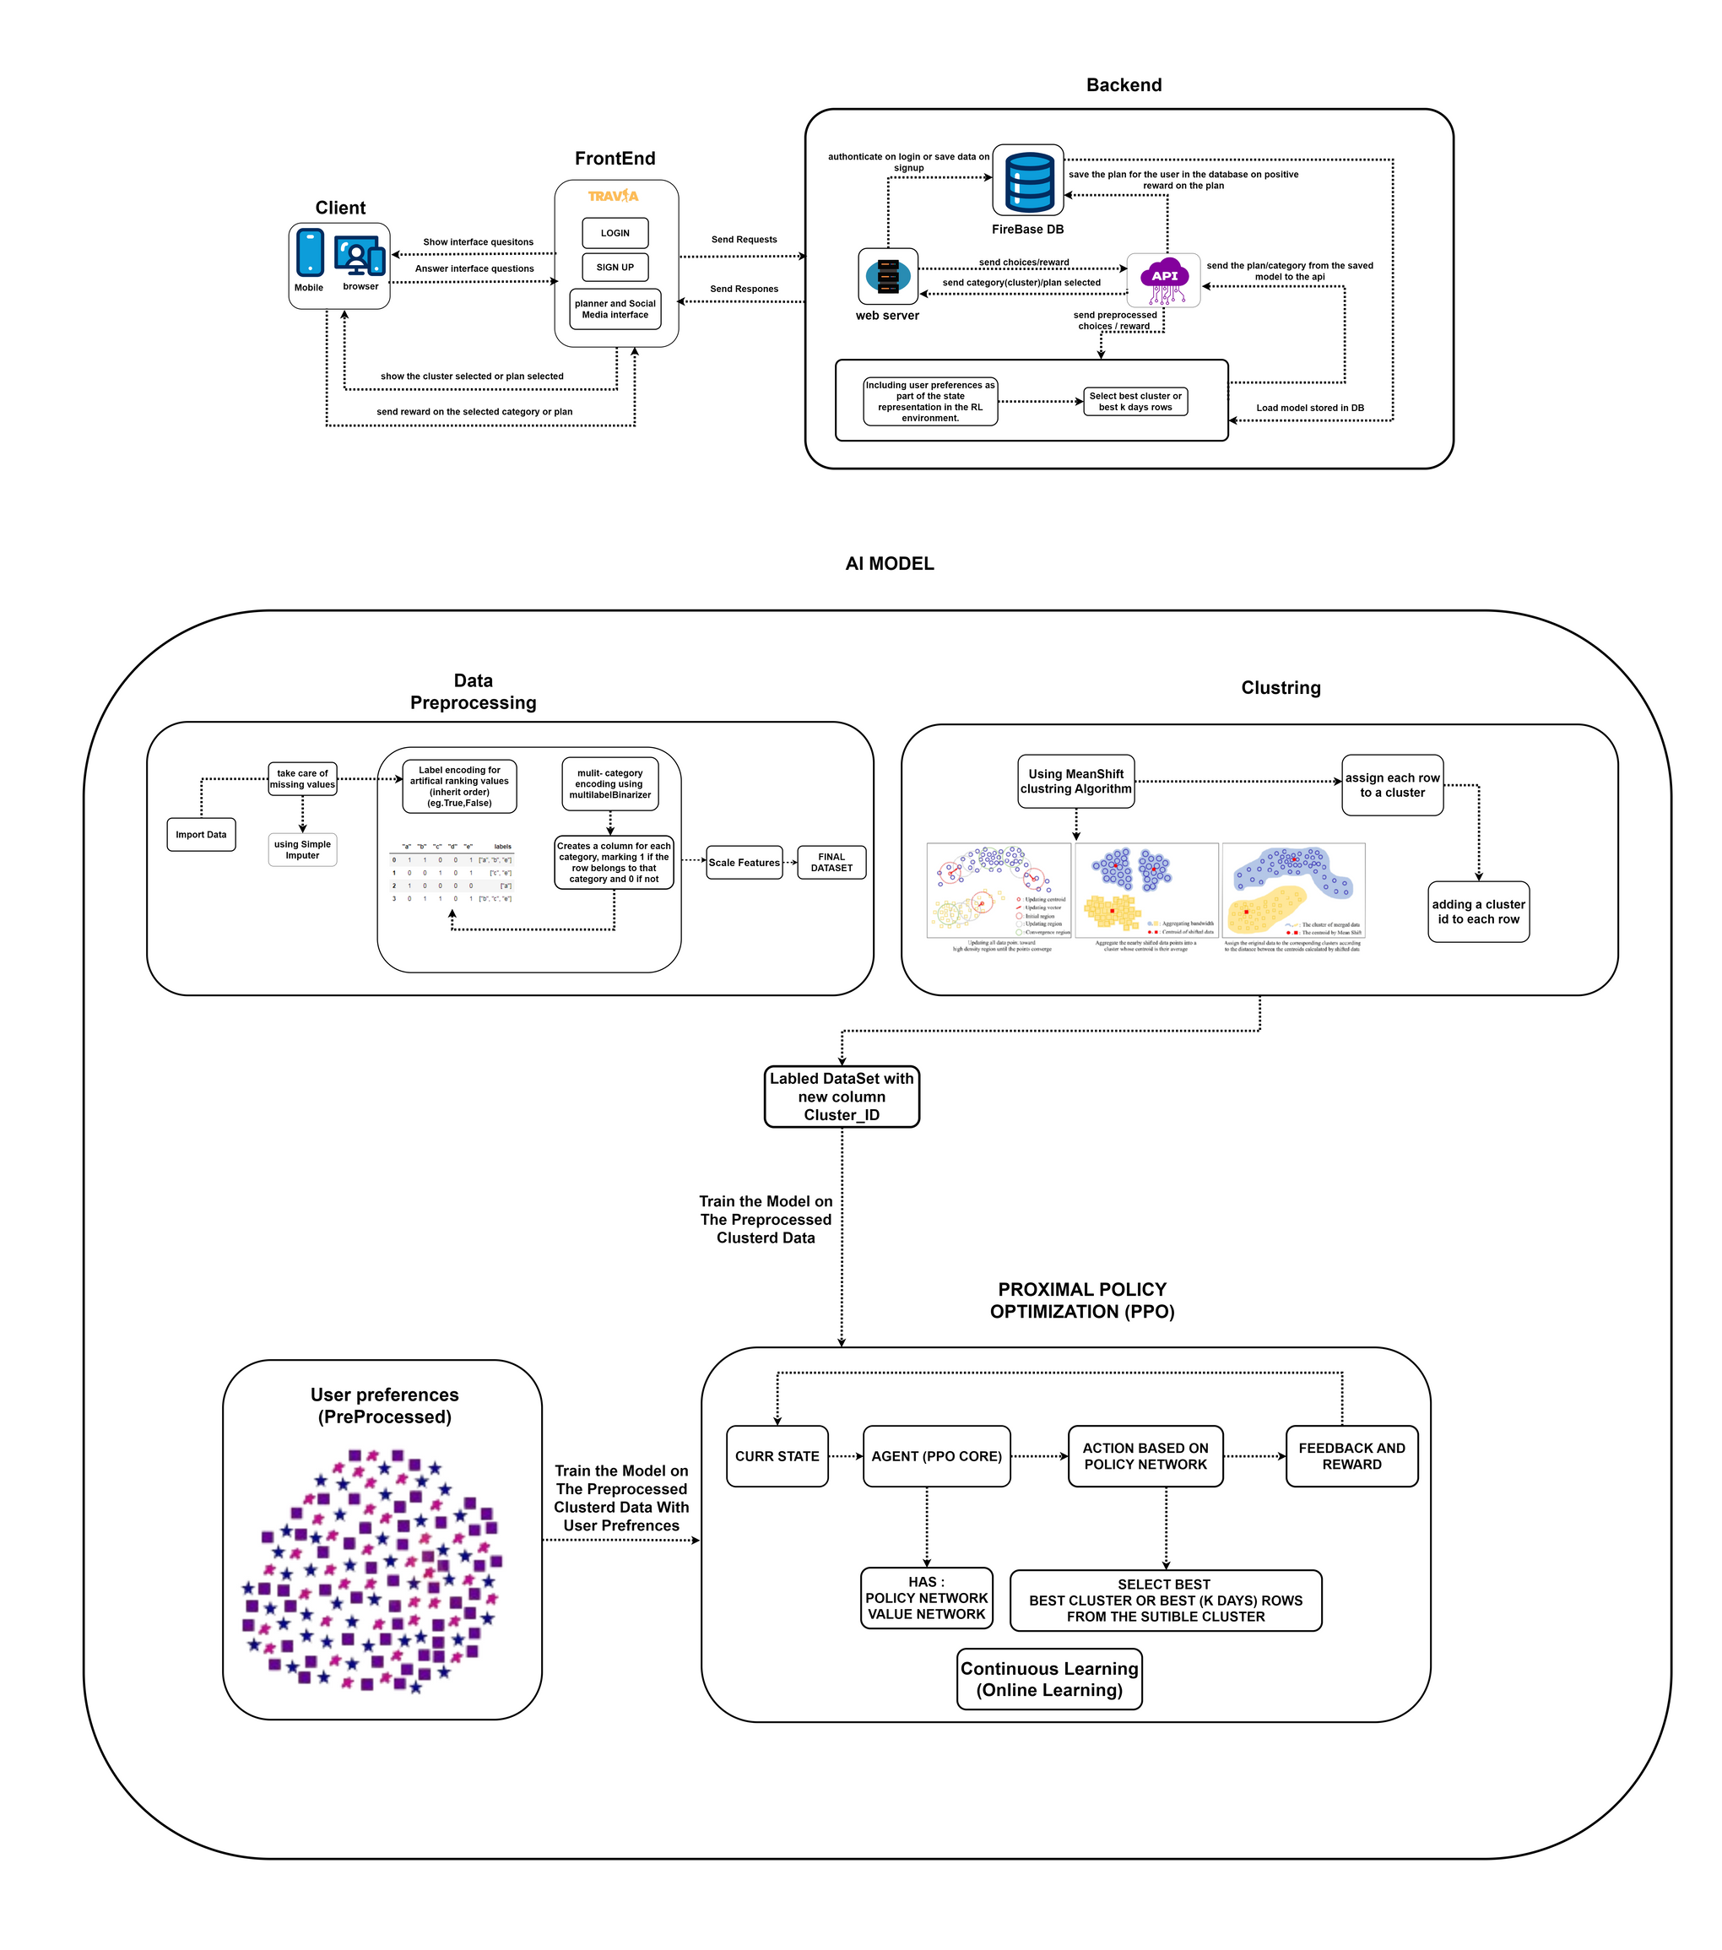
System Architecture

Slide 70
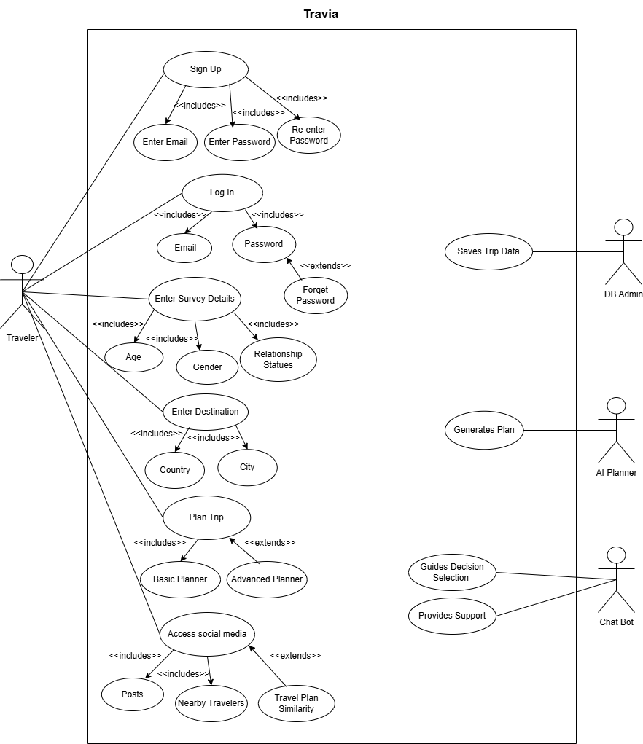
Use Case

Slide 71
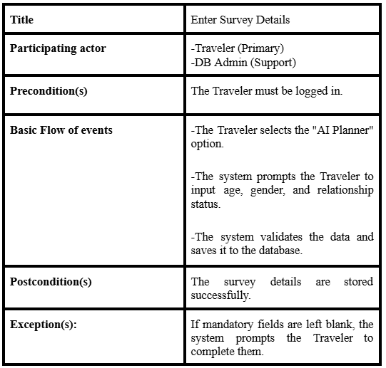
Survey Detailed Use Case

Slide 72
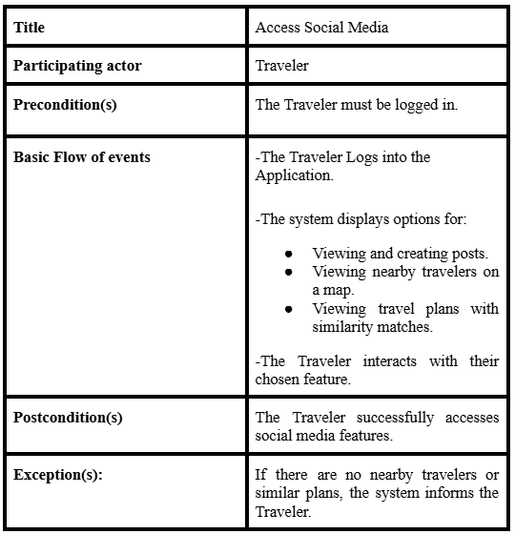
Access Social Media detailed Use Case

Slide 73
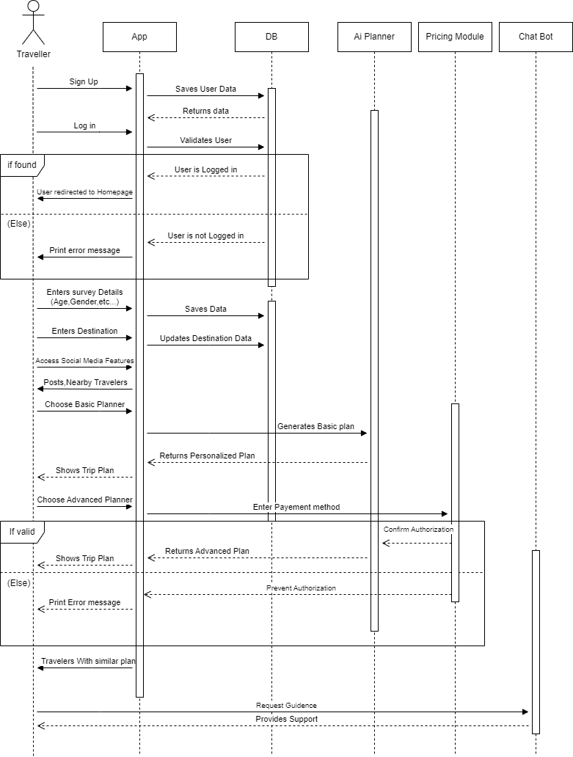
Sequence
Diagram

Slide 74
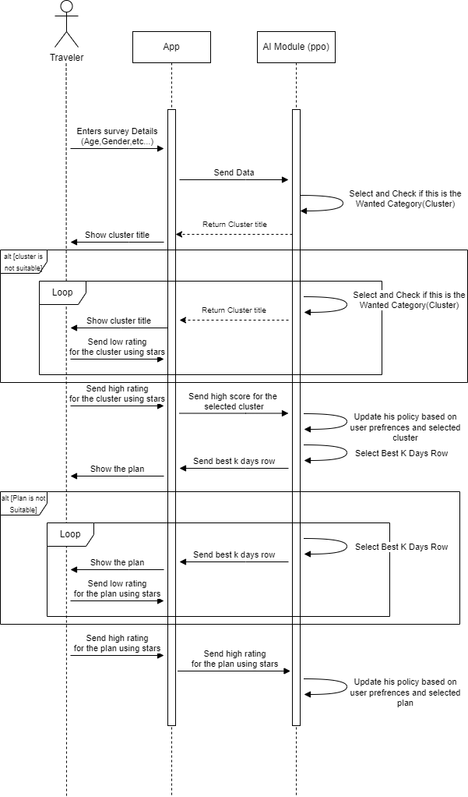
Survey
Sequence
Diagram

Slide 75
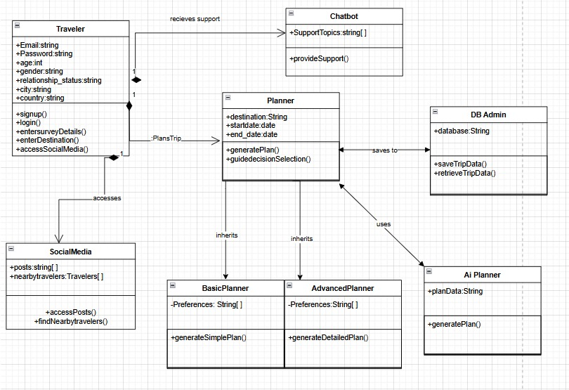
Class
Diagram

Slide 76
6. Data Analysis

Slide 77

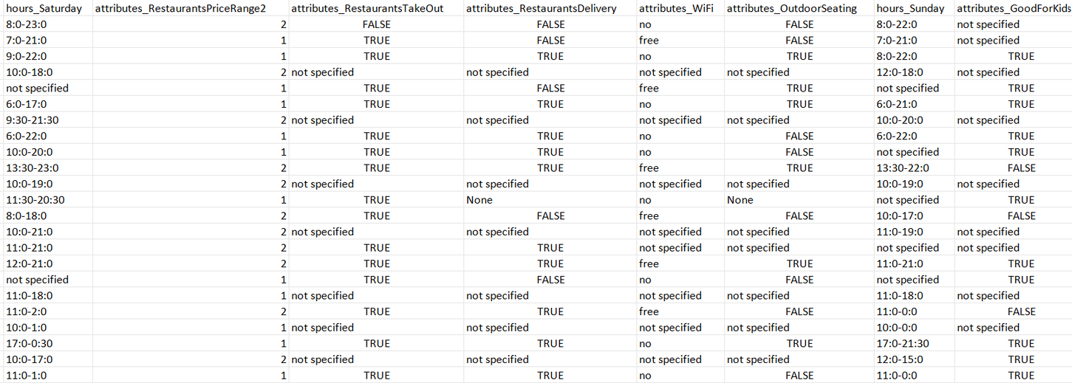
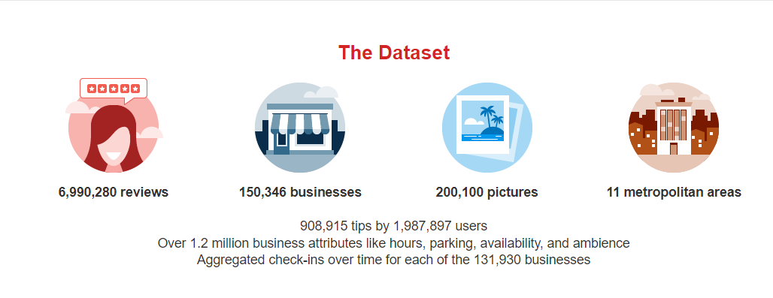
Data Gathering

Slide 78
The tool used for data analysis Python Jupyter, we will mention the charts used and the insights learned from the data.
The data shape after cleaning (85314 rows, 40 columns) is massive,
so we opted to take only a sample of 5000 rows to perform the data analysis on for time purposes.
The data is diverse and perfect for training our machine learning model,
It ranges from:
pricings, ambience, hours of opening, meals, family friendly, categories and more!

Slide 79
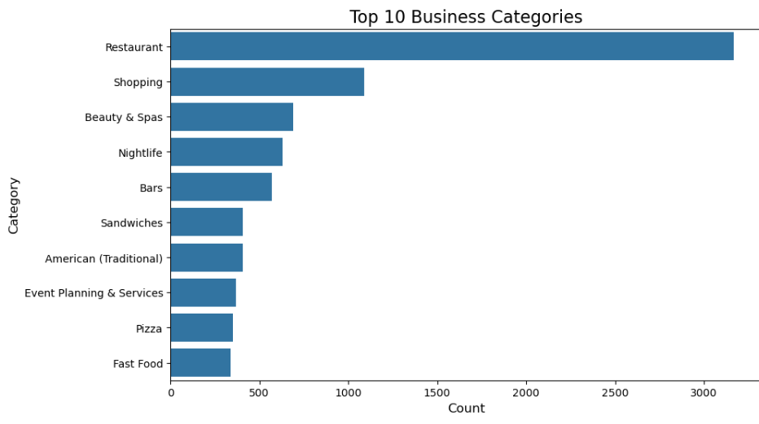
The following figure shows the top 10 categories
Insights: We see that a majority of the data are restaurant businesses, many people consider restaurants are important places to visit for their trips so this aligns well with our findings.

Slide 80
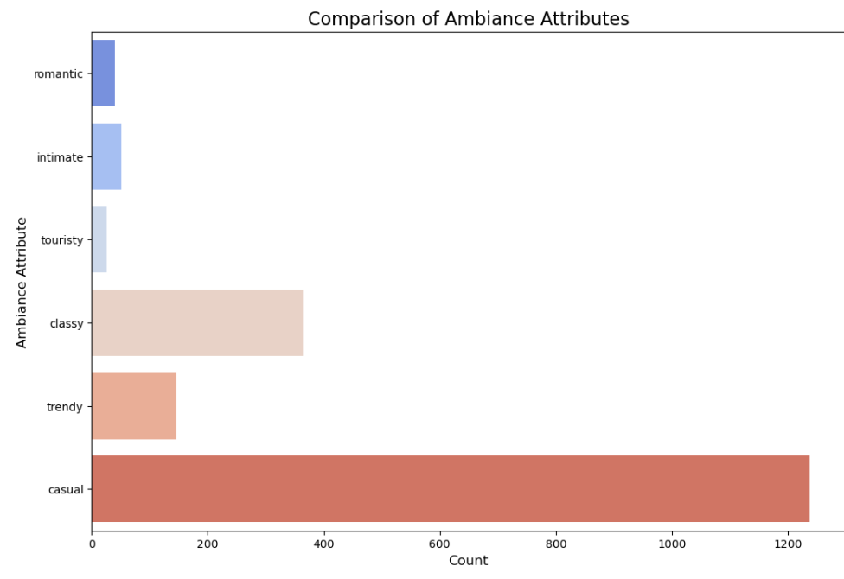
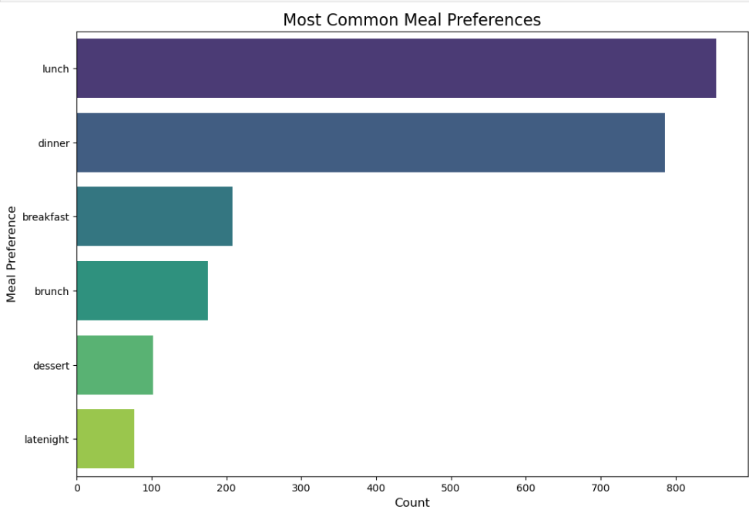
The following figure shows the most important types of businesses
(Tourist – Casual – Romantic etc.) and also another figure
that shows us the most important types of meal preferences (Lunch – Dessert – Breakfast etc.)
Insights: We see that most restaurants serve lunch and dinner meals,
and the most popular types of businesses are casual ones.

Slide 81
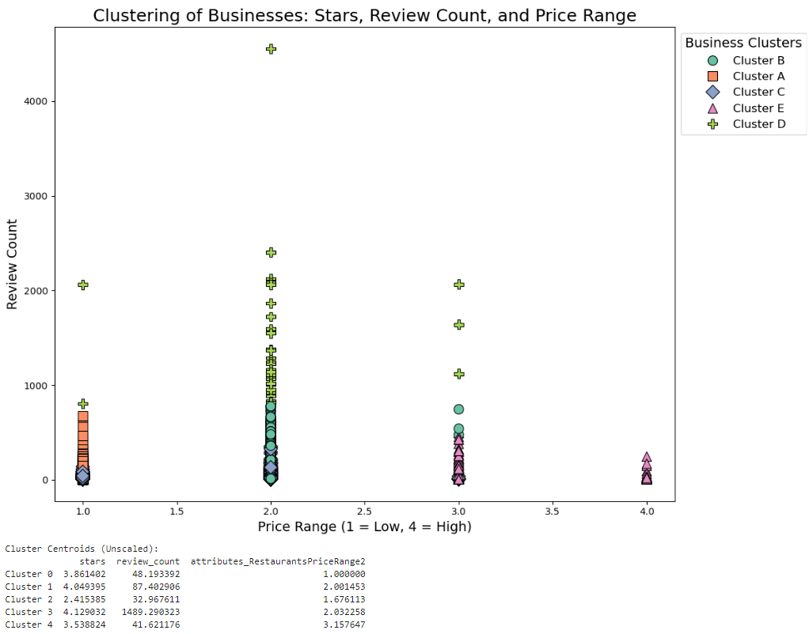
The following figure will show the clustering of businesses according to price and ratings,
Insights: This shows us businesses with a lower price (1,2) are more popular and get more reviews and more ratings.
A certain cluster however (Denoted with a triangle) has higher prices and little to no review counts.

Slide 82
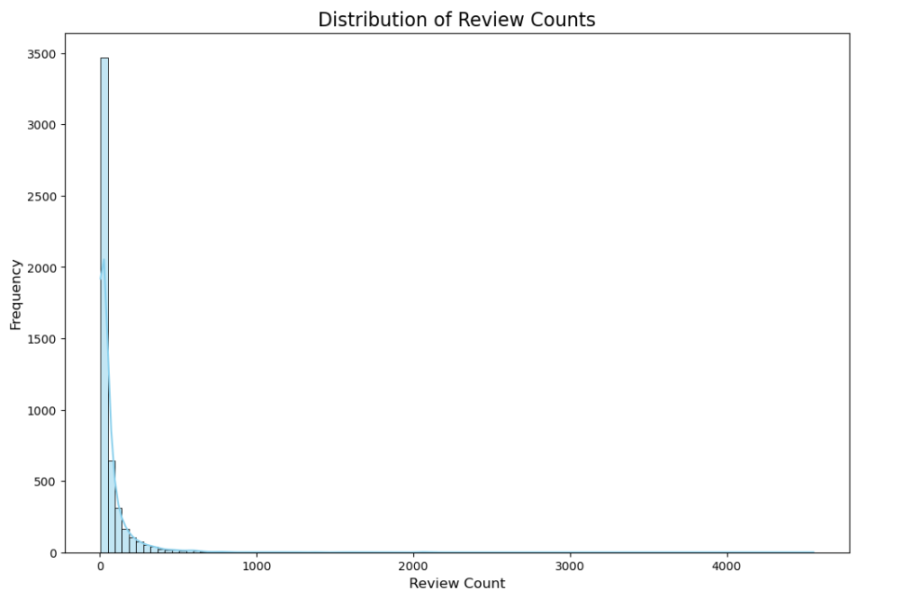
The following figure will show a histogram with the distribution
of review counts for all businesses:
Insights: This shows us that most businesses are not properly reviewed
and businesses with higher popularity (review count) are rare.

Slide 83
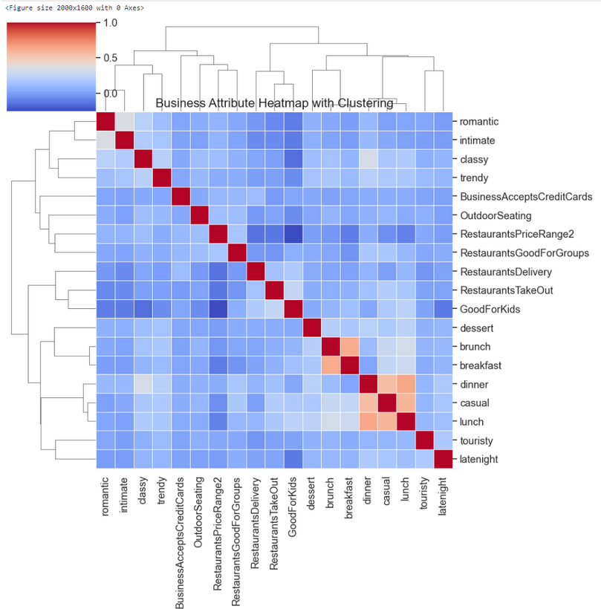
The following figure shows the heat map correlation
between all the attributes:
Insights: The correlation map tells us some powerful insights on how each attribute correlates with other attributes, for example:
Most restaurants who serve breakfast also serve brunch as they have high correlation,
Most restaurants who classify themselves as “casual” serve lunch as well as dinner.
We see that columns like good for kids or restaurant take out have no effect on the pricing as they have little to no correlation.

Slide 84
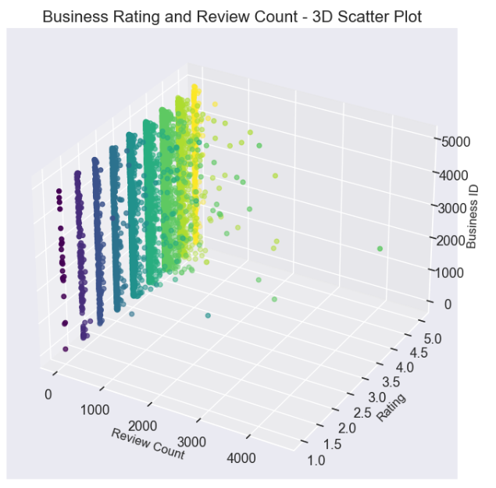
The following figure shows a 3D scatter plot that shows
each business ID, their rating and review counts:
Insight: most businesses fall under the category of high rating and low review count,
as points with high review count are rare, but points where the rating is low is mid.

Slide 85
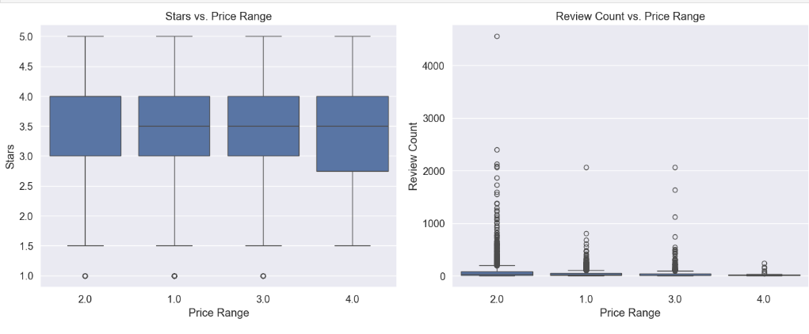
The following figure shows two box plots on
how pricing affects ratings and review counts:
Insights: We clearly see as the price goes down the reviews and stars go up and,
so the prices vastly affect the popularity of each business.

Slide 86
System Prototype

Slide 87
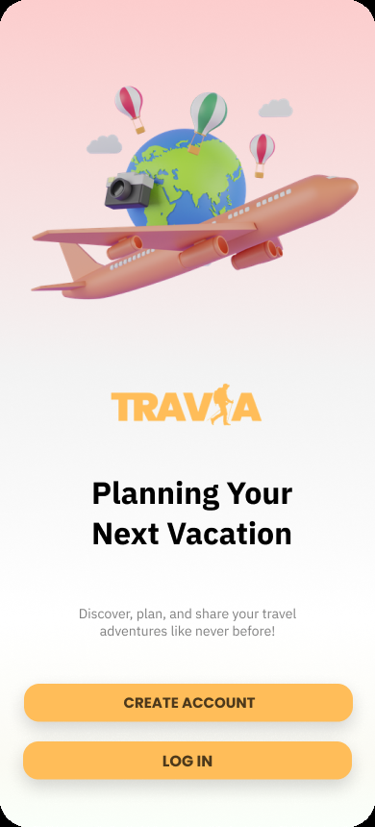
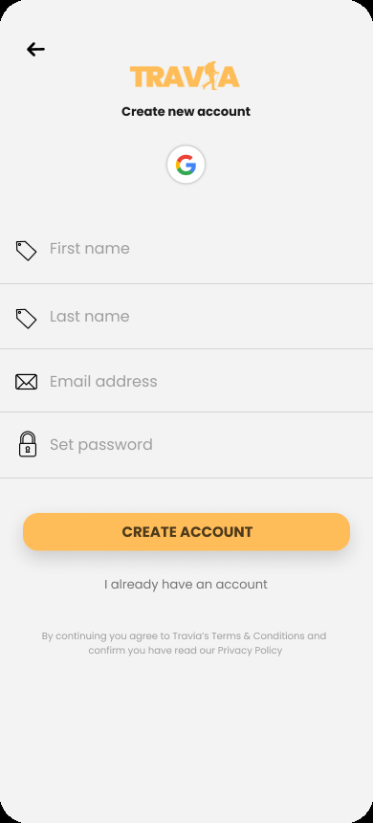

Start Screen
UI
Create Account
UI
Social Media
UI

Slide 88



Survey UI
Destination UI
Trip Planner UI

Slide 89
Status

Slide 90








1- Data and Information Gathering
Researched market gaps and traveller needs.
Collected data for system requirements and AI model training.
Conducted a survey to understand user preferences and travel habits.
2- Brainstorming and Idea Filtering
Defined project goals, objectives, and features, such as the AI travel planning system
and social media integration.
Conducted a SWOT analysis to evaluate strengths, weaknesses, opportunities, and threats.
3- Implemented User requirements
Functional an non functional requirements
4- Designing System Architecture
Created use case diagrams, sequence diagrams, and data flow diagrams.
Developed the class and entity-relationship diagrams for database design.
Developed System architecture and planned the AI Model technologies.
5- Prototyping
Designed mobile app prototypes using Figma for features like login,
destination selection, and trip details.
6- Data Gathering and Analysis
Gathered data from the Yelp dataset and analysed it, we are planning to train the
Ai model using this data.

Slide 91
References:
MARITZOL TENEMAZA, SERGIO LUJÁN- MORA,ANGÉLICADE ANTONIO, (Member, IEEE), AND JAIME RAMÍREZ , "Enhancing Travel Itinerary Recommendations with Contextual Information", IEEE Access, 2020.
C. Cariou, S. Le Moan and K. Chehdi, "A Novel Mean-Shift Algorithm for Data Clustering," in IEEE Access, vol. 10, pp. 14575-14585, 2022, doi: 10.1109/ACCESS.2022.3147951
Jiang, Zhengyong, et al. "CAD: Clustering And Deep Reinforcement Learning Based Multi-Period Portfolio Management Strategy." arXiv preprint arXiv:2310.01319 (2023).
Trip Planner (using Generative AI) - Spoorti Reddy, K Venkat Manideep, R Atuliya, Durgapu Aakash Ganesh, Vinayak Viswan, Prof. Sahana Shetty - IJFMR Volume 6, Issue 3, May-June 2024. DOI 10.36948/ijfmr.2024.v06i03.20089
Villavicencio, Nathan, and Michael N. Groves. "Tuning Reinforcement Learning Parameters for Cluster Selection to Enhance Evolutionary Algorithms." ACS Engineering Au (2024).
‏
6. According to the founderjar website article named 38 Online Travel Booking Statistics & Trends of 2024
https://www.founderjar.com/online-travel-stats/#:~:text=Key%20Online%20Travel%20Booking%20Statistics%201%20The%20size,website%20visits%20before%20deciding%20and%20making%20a%20booking.

Slide 92


Thank You
For Your Attention

